Slide 1
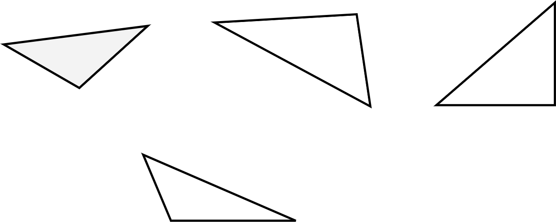
Area of a triangle
Task A: Reviewing the area and perimeter of a triangle
a) b) c)
5 cm
4 cm
2 cm
5 cm
3 cm
2.5 cm
4 cm
5 cm
d)
4 cm
4 cm
3 cm
1) For each triangle, do you have enough information to calculate the area, the perimeter, both or neither?
Explain how you know.
2) For the ones that are not possible, write the minimum additional information you need.
Triangle A:
I can calculate the area but not the perimeter. For the perimeter, I need the remaining side length.
Triangle B:
I can calculate the perimeter but not the area. For the area, I need the length of a perpendicular line from one side to the opposite vertex.
Triangle C:
I can calculate both the perimeter and area.
Triangle D:
I can calculate neither the perimeter nor the area. I need the length of the two remaining sides.

Slide 2






Area of a triangle
Task B: Deriving the formula for the area of a triangle
1) Instructions:
Take a piece of paper and fold it in half.
Draw a triangle on your piece of folded paper (try to make it different from mine).
Cut out your triangle. You should have two identical triangles due to your folded paper.
Put your two triangles next to each other. You can flip and/or rotate either of them.
Which quadrilaterals can you make?
Depending on the triangle drawn, the following quadrilaterals are possible:
Kite Parallelogram Rectangle Square Rhombus Arrowhead
2) Take your two triangles. Can you make each of the 6 quadrilaterals shown below?
List the quadrilaterals you can make.
Which quadrilateral can always be made?
Regardless of the triangle drawn, a parallelogram can always be made.
Rectangles and rhombuses are special types of parallelograms. Squares are special types of rhombuses.
Mathematics in Education and Industry.

